Slide 1
Installation and configuration Demo APP Server
fan bin bin

Slide 2
Networking Structure
Demo Apps, which are installed on smart mobile phones, communicate with the App server installed on a computer used for Service Anchor demonstration. The App server also communicates with the Service Anchor to exchange positioning data. On the Demo App server running computer, users can view positioning results and accuracy and footfall statistics and distribution.

Slide 3
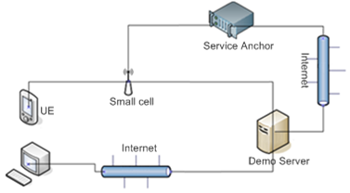
Networking architecture to implement Service Anchor-based positioning

Slide 4
Installation Environment Requirements
Service Anchor Demo App helps operators understand how to employ Service Anchor to serve their enterprise market drives. The software environment for Service Anchor demo can be cloud-based or deployed on a personal computer (PC) that can communicate with Service Anchor Demo App server and client.

Slide 5
Requirements on the installation environment
Item | Requirements
Hardware | CPU: dual-core, 2.9 GHz Memory: 4 GB or above Disk: 60 GB or above
Operating System | Windows 7 (32-bit/64-bit) Windows Service 2008 (32-bit/64-bit)
Software | Java JRE: 1.7 Python: 2.7.9 Tomcat: 7.0 MySQL: 5.0

Slide 6
Installation Procedure
Installing the Service Anchor Demo server consisting two the major steps:
Install the Python software.
Install the Service Anchor Demo server

Slide 7

Installing the Python Software
Obtain the Python software.
You can download the Python software package from the official site or directly obtain it from the Service Anchor tool package.
Download from official site:
To download Python for 32-bit operating system, go to:
https://www.python.org/ftp/python/2.7.9/python-2.7.9.msi
To download Python for 64-bit operating system, go to:
https://www.python.org/ftp/python/2.7.9/python-2.7.9.amd64.msi
Obtain the Python software package from the Service Anchor tool package:

Slide 8
Note
Python 2.7.9 is used in this document. Python communicates with Service Anchor through Secure Socket Layer (SSL).
Python is installed by default in C:\Python27. You can change the default installation path. However, the default path is preferred.

